Slide 1
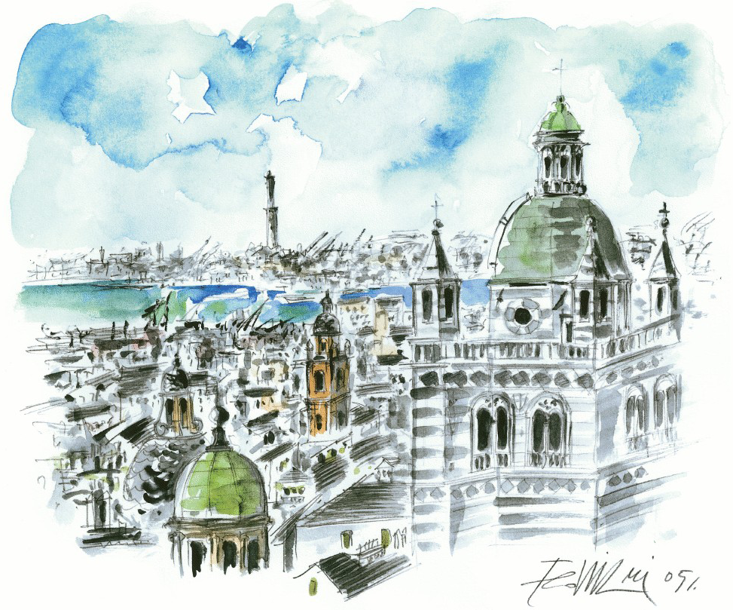
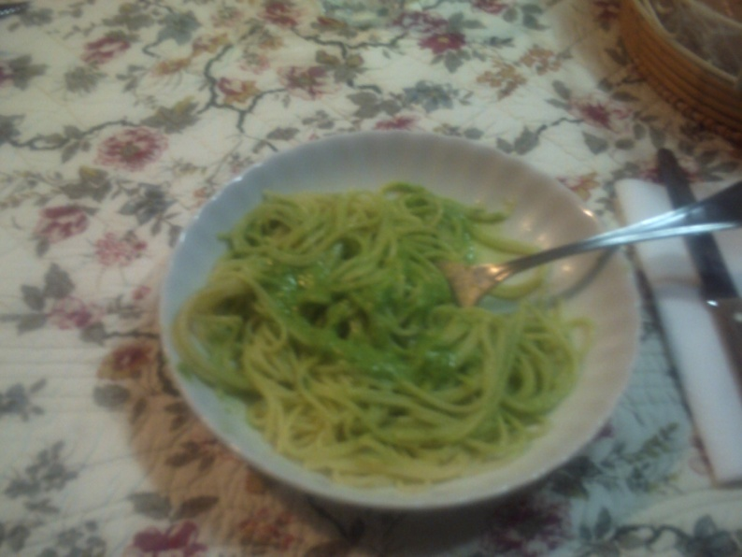
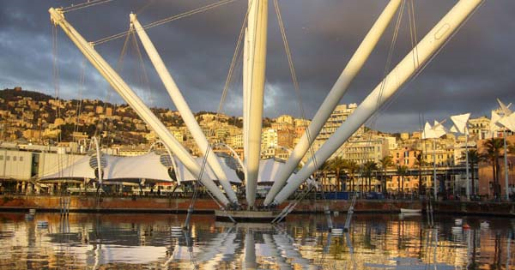
e1-dvcs2 Run Status
Maurizio Ungaro
University of Connecticut and Jefferson Lab

Slide 2
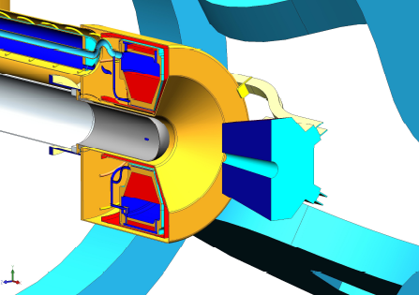
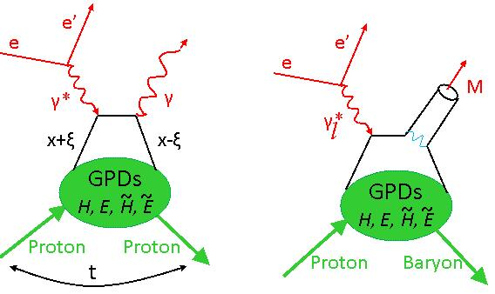
Outline
Data Conditions
New Trigger
Beam Current Scan
Solenoid Current Scan
Solenoid Field Mapping
Data status
e1-dvcs2 and current/future issues

Slide 3
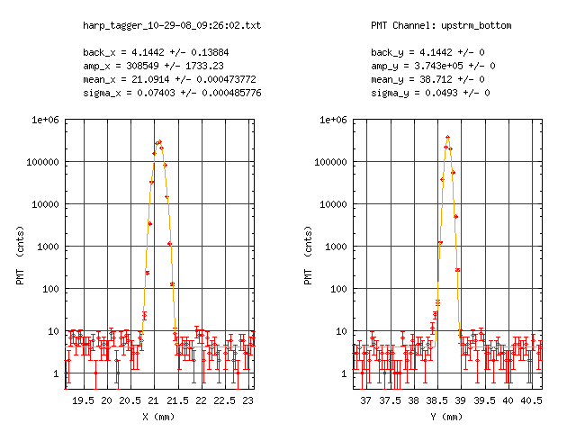
Startup, Run Conditions
Friday Oct 24, 2008 start up after long period of machine shutdown
Good beam tuned on Sunday Oct 26, 2008. Run ended on Jan 24, 2009
12-16 nA Beam current
1.5 -2.0 10³⁴ Luminosity
86% polarization
DC Occupancy 2.5%
Trigger Rate: 3.4KHz
Dead Time: ~10%

Slide 4
Brand New DVCS Trigger Logic
Valery Kubarovsky
New dvcs Trigger Logic is based on the Field-Programmable Gate Array (FPGA)
Commercially available CAEN Module V1495 is a VME board, suitable for various digital Gate/Trigger/Translator/Buffer/Test applications, which can be directly customized by the User.
64 inputs
32 outputs

Slide 5
Brand New DVCS Trigger Logic
424 IC signals
72 hodoscope signals
6 TOF (OR of all counters in each sector)
6 CC inputs (OR of all counters in each sector)
4x6 EC inputs (inner and total energy threshold signals in each sector)
532 input signals in total
Caen-V1495
IC Calorimeter
TOF-6
CC-6
EC(4*6=24)
IC Hodoscope
many independent decisions
in each sector

Slide 6
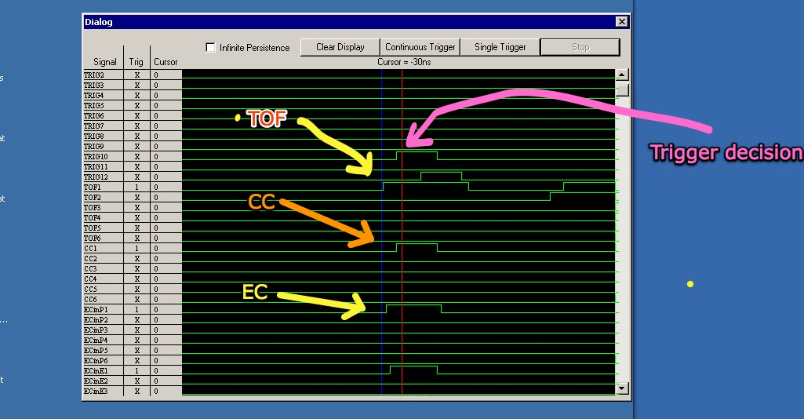
Brand New DVCS Trigger Logic

Slide 7
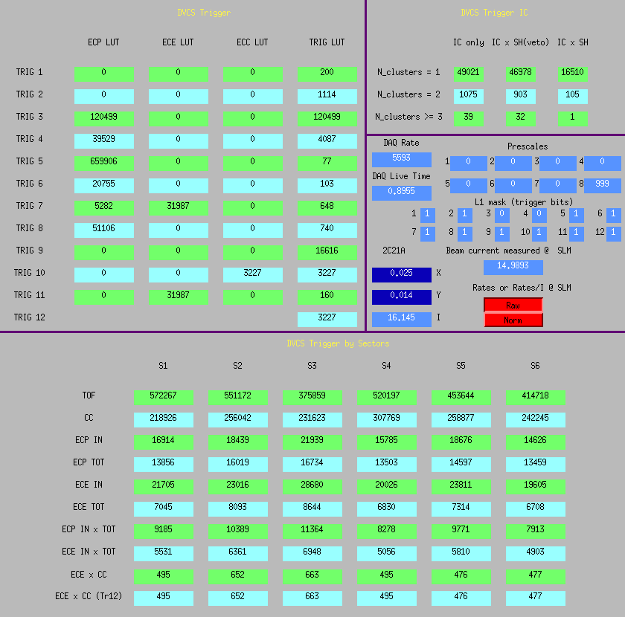
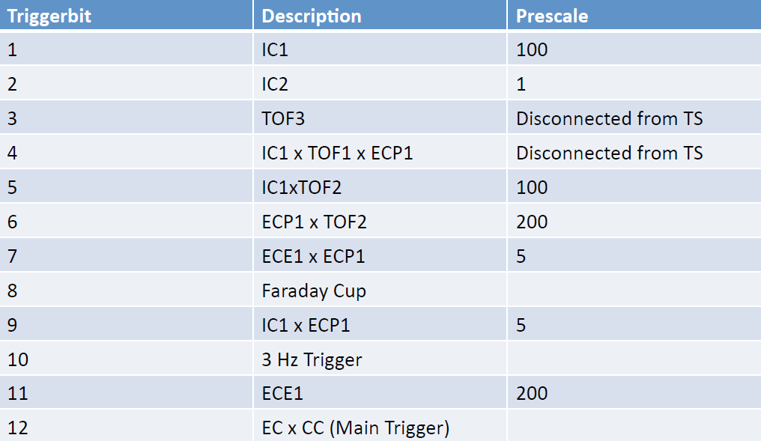
Brand New DVCS Trigger Logic
Perform CC threshold scans from 20-200mV (corresponding to 0.2 – 2 p.e.). Trigger rate changes by factor ~3 *

Slide 8
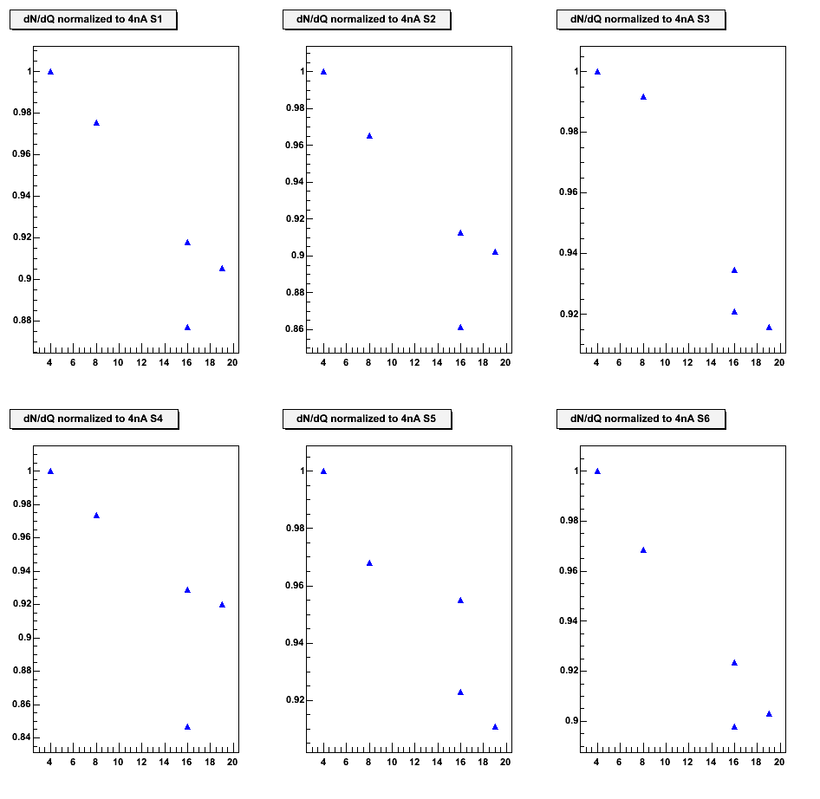
Beam Luminosity Scan

Slide 9
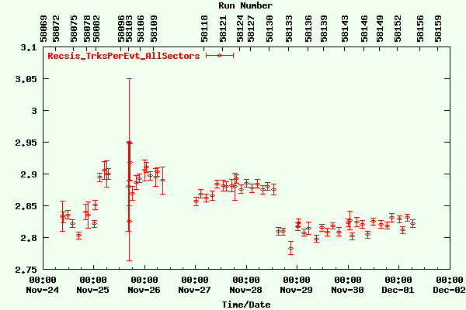
Beam Luminosity Scan
Empty Target

Slide 10
Beam Quality: December 2008

Slide 11
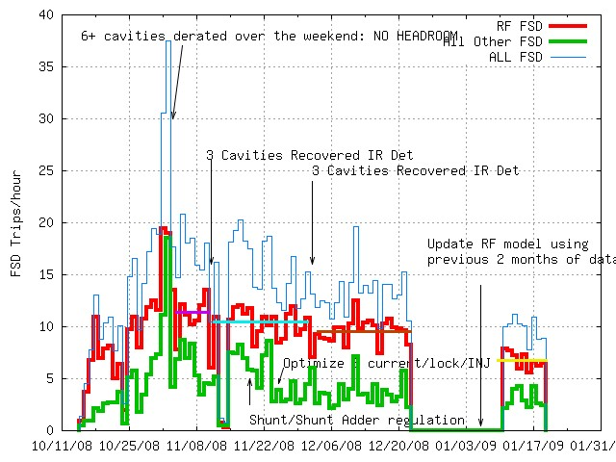
Accelerator RF Model Improved

Slide 12
Beam Quality: January 2009
13 trips in 3 hours

Slide 13
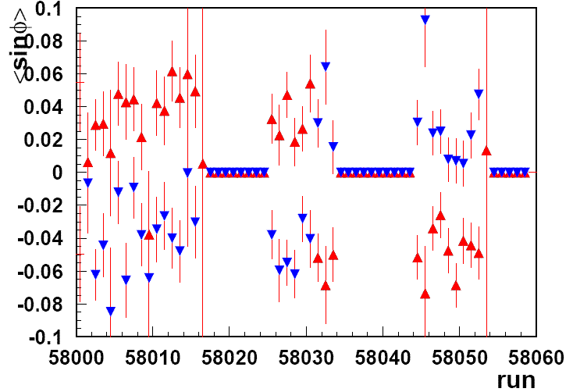
epX asymmetry sinϕ moment
Half-wave plate insertion
85%
Beam
Polarization
Courtesy of Harut

Slide 14
DVCS Solenoid Current Scan:
1/22: DVCS Solenoid Current Scan, Straight Tracks Runs
Current (A) | Run Number | N. of events | R1 DC Occupancy (Axial) | R1 DC Occupancy (Stereo) | DC SA, SS (muA)
534 | 58598 | 21.3M | n/a, n/a, n/a, n/a, n/a, n/a | 1.9, 2.0, 1.6, 2.2, 2.0, 1.9 | n/a
434 | 58599 | 2.26M | 1.8, 1.8, 2.1, n/a, n/a, n/a | n/a, n/a, n/a, 2.46, 2.2, 2.0 | 4.8, 3.9
350 | 58601 | 1.55M | 1.86, 1.89, 2.21, 1.98, 1.97, 2.24 | 2.24, 2.33, 1.78, 2.49, 2.31, 2.12 | 5.8, 4.8
300 | 58602 | 1.88M | 1.96, 1.97, 2.29, 2.10, 2.01, 2.35 | 2.32, 2.43, 1.85, 2.61, 2.41, 2.26 | 4.97, 3.97
267 | 58603 | 5.57M | 1.96, 1.96, 2.25, 2.13, 2.10, 2.37 | 2.34, 2.32, 1.81, 2.64, 2.41, 2.29 | 5.0, 4.0
220 | 58604 | 1.89M | 2.02, 2.08, 2.31, 2.23, 2.11, 2.51 | 2.38, 2.56, 1.91, 2.76, 2.38, 2.27 | 5.16, 4.1
180 | 58605 | 1.96M | 2.21, 2.33, 2.64, 2.41, 2.47, 2.67 | 2.58, 2.81, 2.07, 3.01, 2.83, 2.49 | 5.2, 4.1
160 | 58606 | 2.4M | 2.5, 2.63, 2.78, 2.63, 2.65, 2.83 | 2.85, 3.10, 2.19, 3.23, 3.07, 2.67 | 5.4, 4.2
140 | 58607 | 1.2M | 2.79, 3.14, 3.02, 3.52, 3.26, 2.52 | 2.99, 3.63, 3.15, 3.61, 3.19, 3.01 | 5.7, 4.5
130 |  |  |  |  | 5.9, 4.6
120 | 58608 | 1.74M | 3.5, 4.22, 3.95, 3.92, 4.33, 3.85 | 3.92, 4.7, 3.16, 4.73, 4.81, 3.55 | 6.02, 4.7
110 |  |  |  |  | 6.4, 4.9
100 | DC Trips | DC Trips | DC Trips | DC Trips | DC Trips

Slide 15
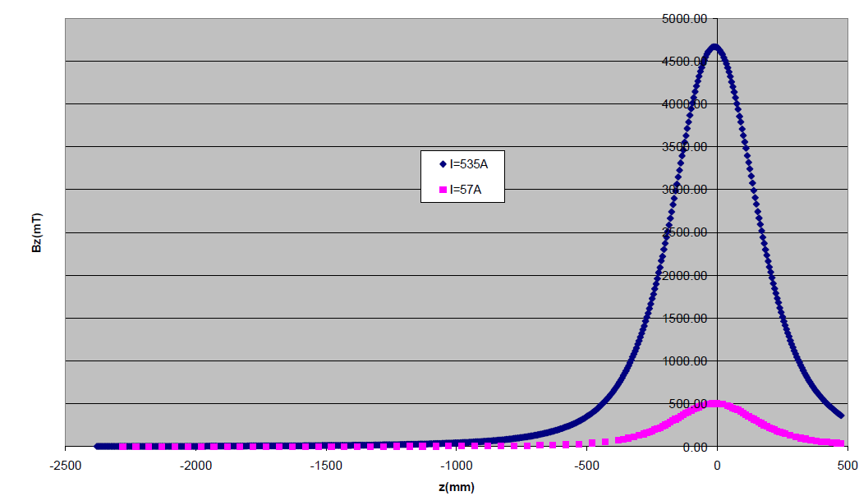
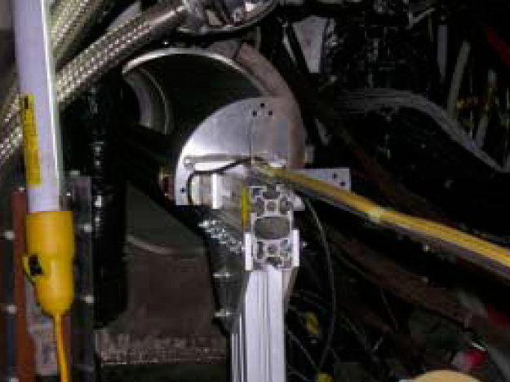
Solenoid Field Mapping
CLAS-Note 2009-009

Slide 16
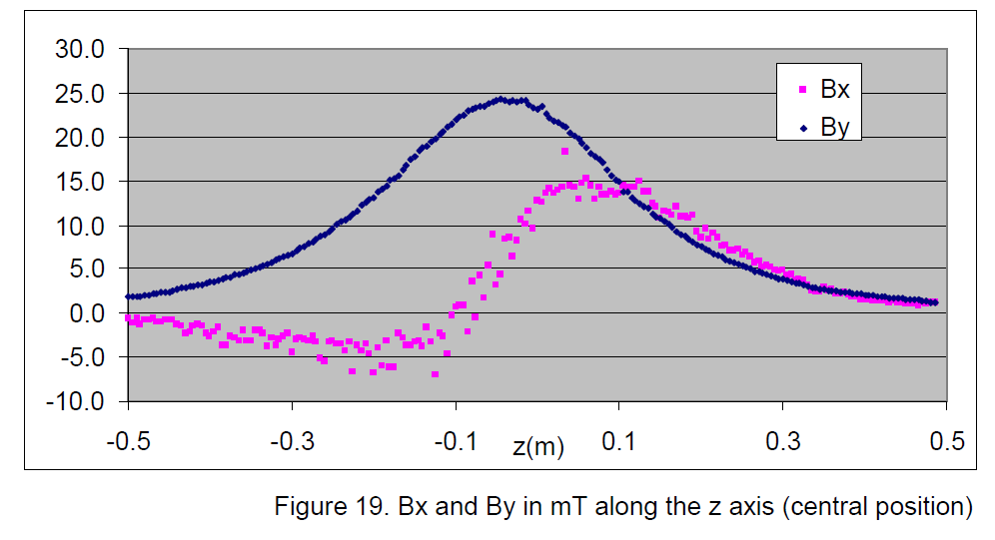
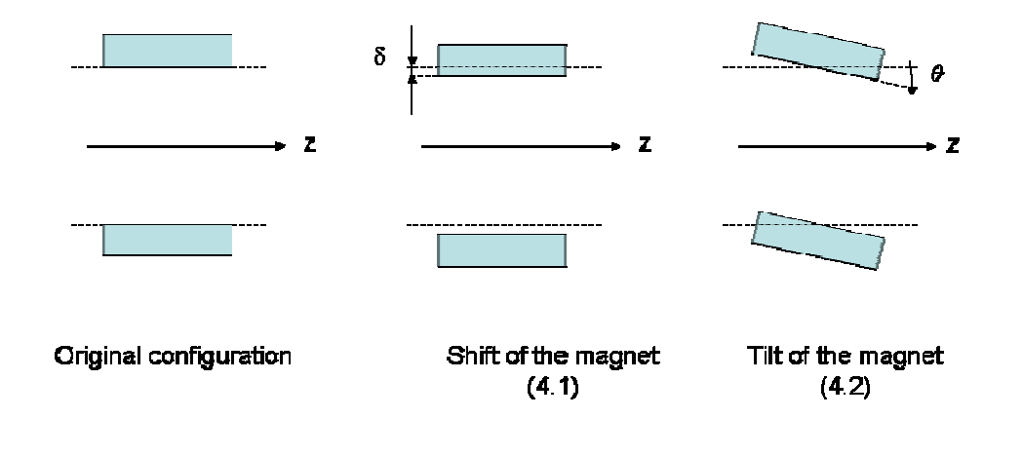
Solenoid Field Mapping
Comparison With Data
Compatible with:
~1mm shift (affects BX)
~0.5 mRad (affects BY)

Slide 17
Various Issues
Shifts / Documentation
Personnel Sometimes not Well Trained to take shifts:
Monitoring histos not printed / looked at all the times
Documentation / Warning Signs not read
Alarm Silenced / Ignored
Start / End Run, non-emergency situations (like Moeller Runs)
What to Monitor
Please:
Come one hour before your shift if it’s your first time

Slide 18
Various Issues
Fedora 8 switch
Reconstruction Software: Black Box
?
Data
Also: Desktops are RHEL5
Software is Fedora 8

Slide 19
Various Issues
Computer Farm:
Factor of 4-5 increase in Jobs submitted
CPU Power is still the same as 5 years ago – no plans to increase it.
We need at least factor of 2 – otherwise:
Forget about processing data in 2 months
Forget about huge simulations
We’re already in “crisis” more – affecting data quality.
Meeting between offline group and CC staff
Action needed: buy nodes, disk space.
Estimated Costs: 60-100K.

Slide 20
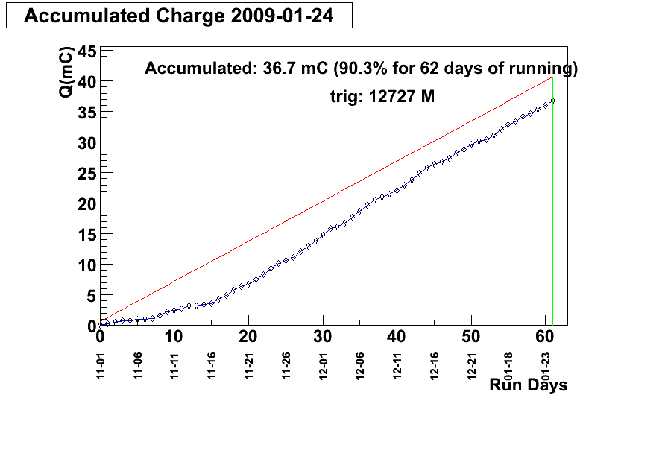
Conclusions
Calibration is Ongoing
~900 Runs
100 TB of data

